Slide 1

Bank Loan Report
Using SQL & Power BI
FINANCE

Slide 2
Objective :
__________________________________________________________________________________________________
The primary objective of this report is to analyze KPIs, total loans disbursed, total receivable loan amounts, DTI and other key metrics. Additionally, it aims to create a user-friendly, fully interactive dashboard that demonstrates business performance and enables data-driven decision-making.

Slide 3
PROBLEM STATEMENT :
__________________________________________________________________________________________________
Key Performance Indicators (KPIs) :
____________________________________________________________________
Total Loan Applications:
Total Funded Amount:
Total Amount Received:
Average Interest Rate:
Average Debt-to-Income Ratio (DTI):
Good Loan v Bad Loan KPI’s

Slide 4
PROBLEM STATEMENT :
__________________________________________________________________________________________________
2. Overview :
__________________________
Monthly Trends
Regional Analysis
Loan Term Analysis
Employee Length Analysis
Loan Purpose Breakdown
Home Ownership Analysis

Slide 5
Functions used in this project :
__________________________________________________________________________________________________
SQL - MS SQL server
Creating Database
Creating Table
Select
Datename
Datepart
Cast
Decimal
Month
Hour
Day
Group by
Order by
Decimal
Limit
Count
Distinct
CTE
Partition

Slide 6
Functions used in this project :
__________________________________________________________________________________________________
POWER BI
Connecting to SQL Server
Data Cleaning
Data Modelling
Data Processing
Power Query
Date Tables
Time Intelligence Function
DAX
Navigations
Date Function
Text Function
Filter Function
Calculate
SUM/ SUMX
Creating KPI’s
New Card Visual
Creating Charts
Formatting visuals
Creating Functions

Slide 7
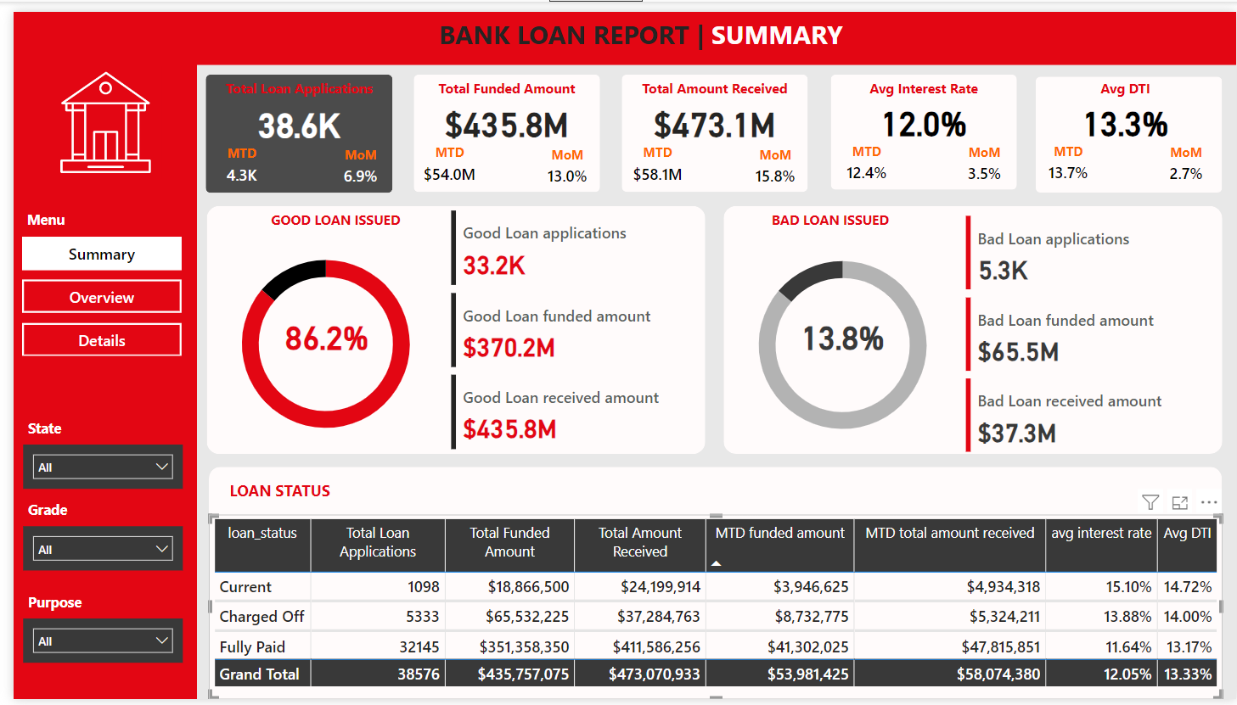

Slide 8
BANK LOAN REPORT | SUMMARY
__________________________________________________________________________________________________
The dashboard provides a comprehensive overview of key performance indicators (KPIs) for the business, including:
Total Applications: 38.6k applications
Total Disbursed Amount: $435.8M
Total Amount Received: $473.1M
Total Profit: $37.3M
Average Interest Rate: 12.05% P.A.
Average Debt-to-Interest Rate: 13.33%
Loan Performance:
Good Loans: 86.2%
Bad Loans: 13.8%
By comparing good and bad loans, the bank has successfully recovered approximately $37.3M.

Slide 9
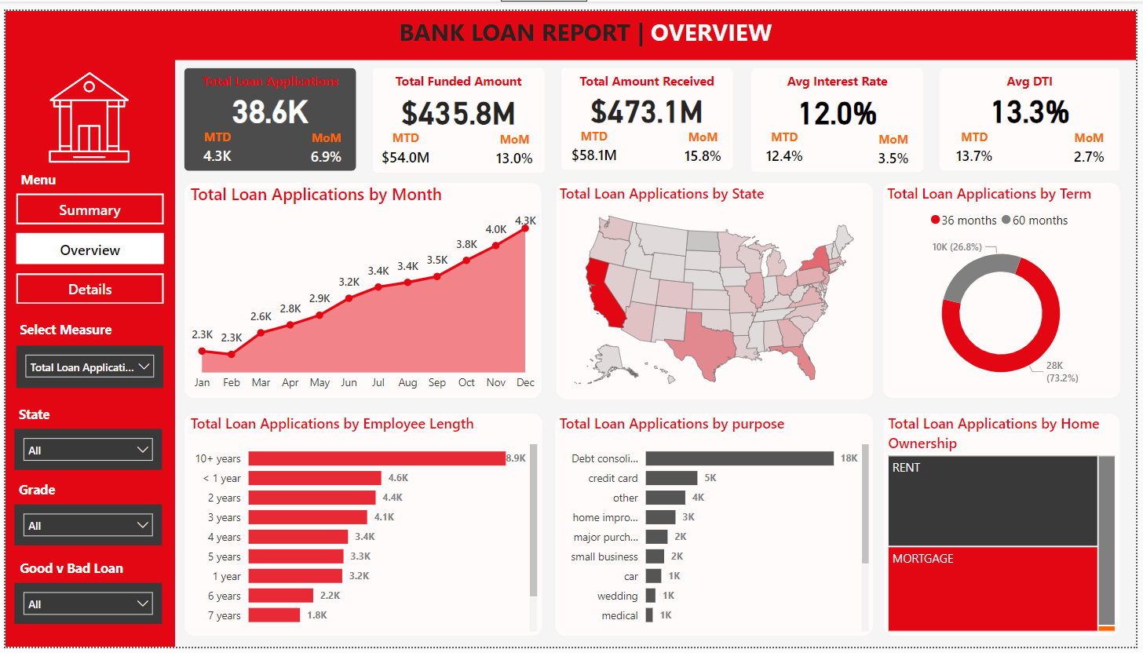

Slide 10
BANK LOAN REPORT | OVERVIEW
__________________________________________________________________________________________________
Monthly Trends: Identifies seasonality and long-term trends in lending activities.
Regional Analysis: Identifies regions with significant lending activity and assess regional disparities.
Loan Term Analysis: Understands the distribution of loans across various term lengths.
Employee Length Analysis: Assesses how lending metrics are distributed among borrowers with different employment lengths, evaluating the impact of employment history on loan applications.
Loan Purpose Breakdown: Provides a visual breakdown of loan metrics based on the stated purposes of loans, aiding in the understanding of the primary reasons borrowers seek financing.
Home Ownership Analysis: Offers a hierarchical view of how home ownership impacts loan applications and disbursements.

Slide 11
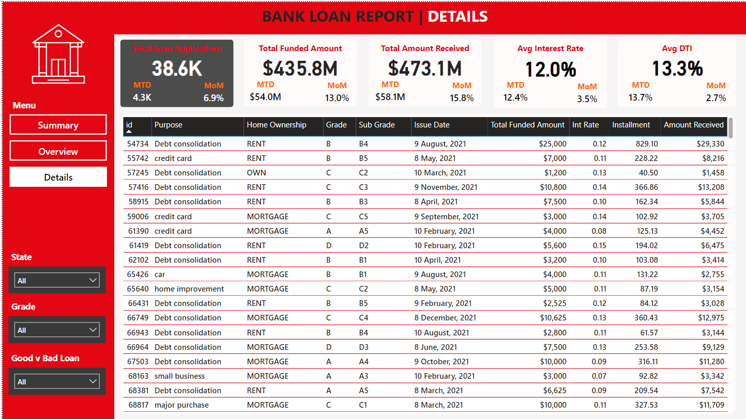

Slide 12
BANK LOAN REPORT | DETAILS
__________________________________________________________________________________________________
This Details Dashboard provides a consolidated view of all the essential information within the Bank Loan Data and offers a holistic snapshot of key loan-related metrics and data points, enabling users to access critical information efficiently.

Slide 13
KEY INSIGHTS :
__________________________________________________________________________________________________
The total amount received exceeds the total amount disbursed, resulting in a profit of $37.3M over the funded amount, which is favorable for the bank.
Good loans significantly outnumber bad loans, reflecting positively on the loan portfolio quality.
There is room for improvement in managing bad loans, as the bank has been unable to recover $28.2M in loan amounts.
Both the funded amount and the amount received are growing month-over-month, indicating success in loan distribution.
Employees with over 10 years of service account for the highest number of applicants.
California (CA) is the leading state in terms of the number of applicants, amount funded, and amount received.
The 36-month loan term is the most popular among customers.

